Slide 1
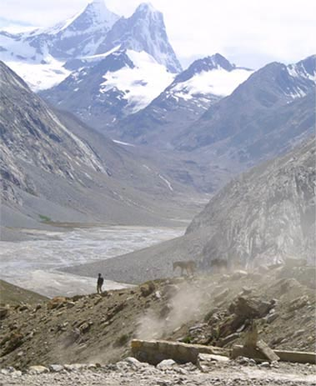
Fellowship of the Heart
Getting Started — the Four Connects, walked around the table on alternating evenings
Evening Series 2026–27 · at the Tittle home · v1.5E DRAFT
All Scripture: ESV · The Companion lesson plans carry the full scripts — these slides carry the room
1
Notes:
DECK TITLE · pre-session · DIVIDER
On screen as the room assembles on night one. All Scripture ESV; the plans carry the scripts; these slides carry the room — and these notes carry you.

Slide 2
SESSION 20
The Long Walk
The dry-season teaching comes home — taught to the whole room by its own senior teens, the night before the sendings
Quarter 4: Consolidation & Sending
244
Notes:
S20 · pre-session · DIVIDER
On screen through dinner and as the circle forms. Greet at the door — the slide holds the room. Journals spotted at the door — quiet paper to anyone without one, no fuss, no spotlight. Folders each hold a fresh Signs Card and Path Home Card; survey stack and return bin visible by the door. Doors close at 7:00.

Slide 3
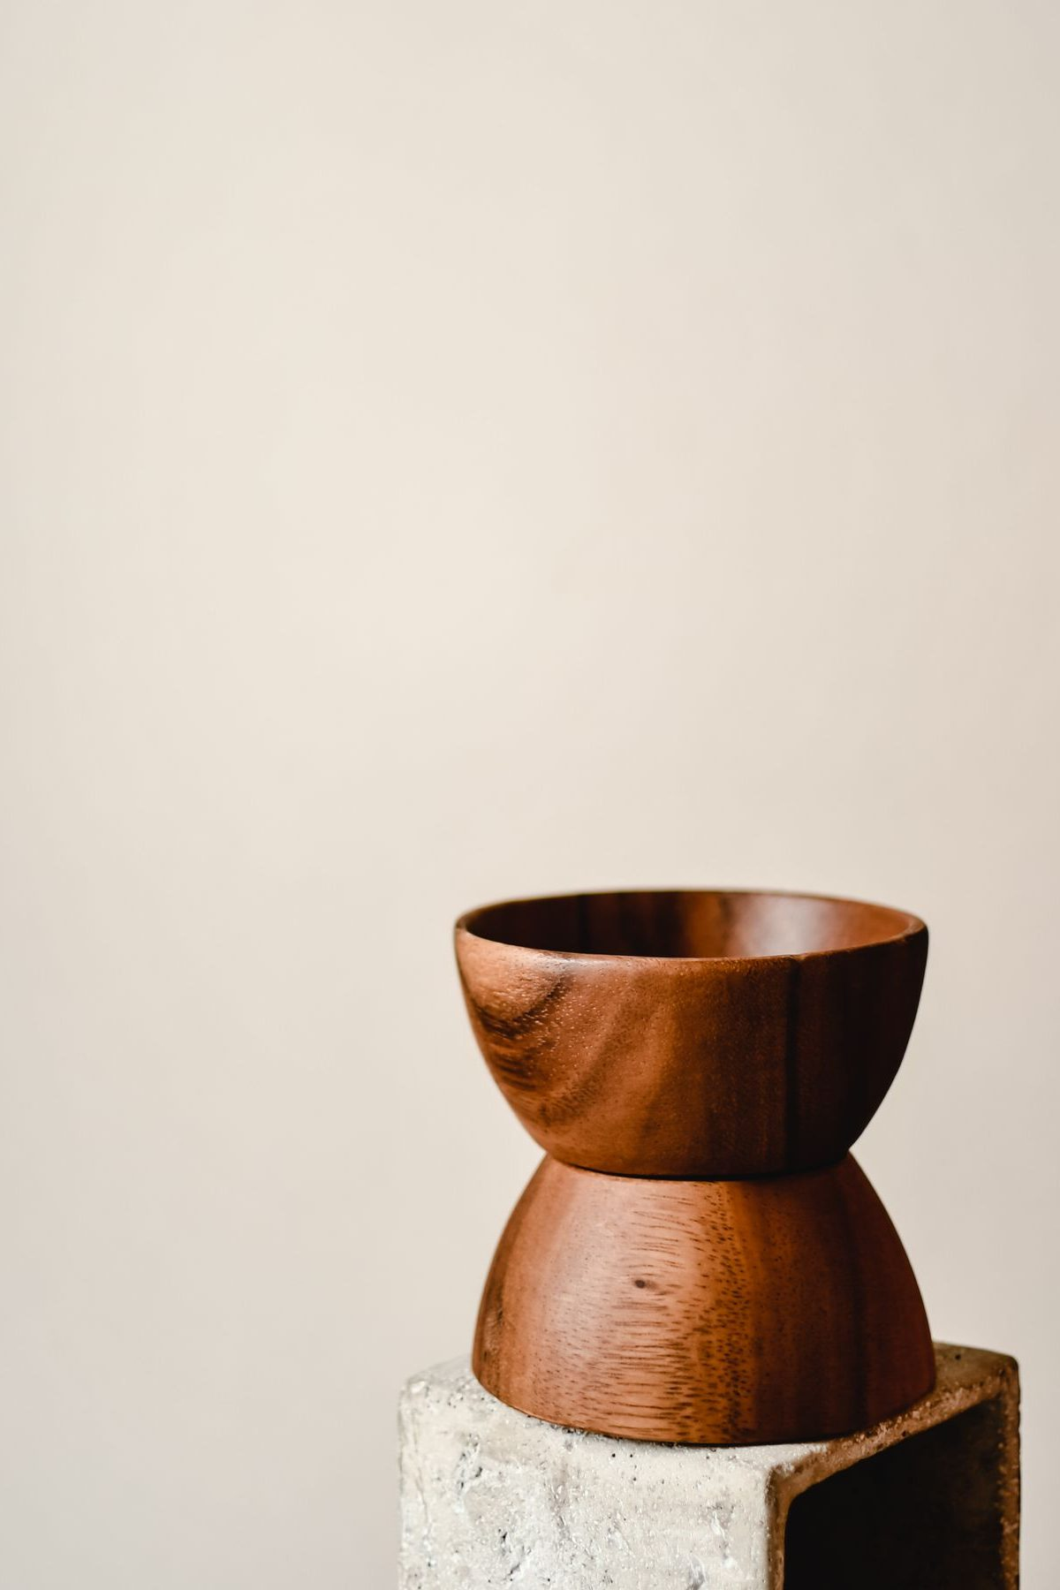
Session 20 — Tonight’s Road
1 Welcome and centering
2 Why tonight — Isaiah 50:10
3 The Signs Card — taught by a CiF
4 The Path Home Card — taught by a CiF
5 The journal arc review
6 One sentence, and the testimony gathering
7 The Post-Series Survey
8 The Leader Feedback Round — both leaders
9 Closing container
245
Notes:
S20 · 7:00–8:30 · LEAD: BOTH LEADERS CIRCLE
BEATS:
1. Frame: nothing new is asked of the room today — it receives. The seniors teach the year's weightiest pastoral equipment (their final rep before commissioning); then the journals walk the year back; then testimonies are gathered for the two sendings.
2. Shape: open, why-today, Signs Card (CiF), Path Home Card (CiF), journal review, pairs for one sentence and the gathering, survey, feedback, close.
3. The whole team's job all night: hold the floor steady under the teaching seniors.
GUARD: The dry-season teaching will describe somebody's current life — the adults watch faces; nobody is looked at or asked; the follow-up is offline within 48 hours. Section 6 protocols stand.

Slide 4
Opening Container — the Eight Steps
1 Welcome — five minutes to open the container
2 Phones silenced and put away
3 Stand in a circle
4 One-word check-in — how you actually are, right now
5 Put out / bring in — set something down; bring a blessing in
6 Spoken commitment: “I am here. I am paying attention. I am willing to be moved.”
7 Opening prayer — “Holy Spirit, you are welcome here. Speak. We are listening.”
8 Sit. Begin.
246
Notes:
S20 · 7:00–7:08 · LEAD: CONTAINER HOLDER CIRCLE
BEATS:
1. The senior opens from memory: blessing first, phones away, the container reminder, the shape of the night, then the standard protocol whole.
2. Sit where the senior can find your eyes and otherwise do nothing.
3. Resist adding a welcome on top of the senior's welcome — this is one of the last container reps before Week 22 asks for it in public.

Slide 5
Why Tonight — Isaiah 50:10
• In two weeks this room stops meeting — the next two Wednesdays are sendings, not endings. On the other side: a summer with no Wednesday in it.
• Somewhere out there — this summer, or in twenty years — every person in this room will hit a season where the practices go gray
• The most dangerous thing on the long walk is not the dryness — it is the wrong diagnosis of the dryness
• So tonight we hand you the equipment for that season — on purpose, at the threshold, before anyone needs it
• Psalm 23:4 — “Even though I walk through the valley of the shadow of death, I will fear no evil, for you are with me.” The road goes through.
• Now the teaching — in the seniors’ voices, not ours
ISAIAH 50:10
“Who among you fears the LORD and obeys the voice of his servant? Let him who walks in darkness and has no light trust in the name of the LORD and rely on his God.”
247
Notes:
S20 · 7:25–7:31 · LEAD: CONTENT PRESENTER CIRCLE
BEATS:
1. Name the threshold honestly: in two weeks the room stops meeting; on the other side of the sending is a summer with no evenings — and someday a season where the practices go gray and a voice misdiagnoses it.
2. Land the key phrase: we hand out this equipment BEFORE anyone needs it — it gives the person currently dry cover; everyone receives, no one is looked at.
3. Read Isaiah 50:10 slowly from the physical Bible — fearing, obeying, AND walking in darkness, all at once; then step back. Do not preach it.
4. Introduce the teachers by name and hand them the room.
GUARD: Seven minutes, no more — the night belongs to the seniors.

Slide 6
The Signs Card — the Four Kinds of Dry
• The danger is not the dryness — it is the wrong diagnosis. One question sorts everything: “Which way does the desire point?”
1 Neglect — the desire has faded and the distance doesn’t ache; the world tastes fine. First step: wake and turn — rebuild the rhythm
2 Worn out — the desire is buried under duty; you want escape, not God. First step: rest — a lighter yoke, smaller faithful steps, stay put
3 The enemy’s dry wind — accused, pressured, a voice counseling change: quit, undo, leave. First step: resist — change nothing, pray a little more, tell someone
4 God’s own stripping — the desire intact and starving; the ache is the sign. First step: receive — wait, stay faithful, stay accompanied
• Three and four command opposite motions — one says fight, the other says yield. When you cannot tell which you are in, do not decide alone — that is what Companions are for.
– Four rules on the card — your own heart only; in every case, tell someone; no big decisions in the dark; know when to call the doctor
THE SENTENCE TO CARRY HOME
“The fact that His absence hurts you is the evidence that He has not gone. Drifting hearts do not ache. Abandoned fields do not thirst. A dry season is not a verdict.”
248
Notes:
S20 · 7:31–7:46 · LEAD: CONTENT PRESENTER CIRCLE
BEATS:
1. CiF 1 teaches standing, card as a net, six numbered points: why the card exists; the tide; the sorting question written LARGE (Which way does the desire point?); the four columns ~1 min each; cases 3 and 4 — opposite motions, never decide alone; the four rules and the carry-home sentence (the ache is the evidence He has not gone).
2. From the floor: hold steady and stay out of the teaching.
CUES: The named adult catch sits in the senior's sight line — close enough to step in inside three seconds, never beside them. Freeze-recovery: the catch picks up at the next numbered point and hands back the moment the senior reaches for it. A stumble is never the story of the night.
GUARD: If the teaching visibly lands on someone, a SECOND adult (not the catch) moves quietly to sit beside them; the teaching continues; the senior never holds the person.

Slide 7
The Path Home Card — the Written Door
• For the one who leaves and concludes a room like this would not want them back — most churches leave the way back unwritten. Not here.
1 Come as you are — conviction is specific and hopeful and draws you toward home; shame is vague and hopeless and drives you away
2 Tell it straight — to God in plain words, and to one trusted person; you choose the person and how much
3 Grieve what needs grieving — lament is faith with tears in its voice
4 Return to the table — small; do not start over, begin again on the next available day
5 Let it be celebrated — in the Lord’s own story of return, the ending is not a probation meeting. It is a feast.
• The witnessed filing — everyone files the card now, while we watch each other do it: “The door is not locked. The light is on.”
LUKE 15:20
“But while he was still a long way off, his father saw him and felt compassion, and ran and embraced him and kissed him.”
The father was watching the road. He ran first, embraced first, and asked for no accounting before the robe.
249
Notes:
S20 · 7:46–7:55 · LEAD: CONTENT PRESENTER CIRCLE
BEATS:
1. CiF 2 teaches with their own named catch, five points: why the card exists; the five steps; Luke 15:20 read exactly — the father runs; both sides of the door (how to return AND how to receive a returner); the witnessed filing.
2. The filing is a real moment, not a logistic — ten full seconds of silence; let the room hear the folders close: the door is not locked; the light is on.
CUES: Same catch and freeze-recovery as the Signs block — pick up at the next numbered point, hand back when the senior reaches for it; a stumble is never the story of the night.
GUARD: An adult moves to sit beside anyone the teaching lands on; the teaching continues; the senior never holds the person. Section 6 stands.

Slide 8
The Journal Arc Review
• Take out your journal — the one you have been writing in since September. If yours is missing, take paper and walk the year from memory.
• Go back to the beginning and read forward — you’re walking the road again, not re-taking the class
1 Where did I begin?
2 Where did He meet me? — mark those pages; fold a corner
3 What do I not want to lose?
• Twelve minutes, in quiet — parents and teens both. Then find your one sentence.
250
Notes:
S20 · 7:55–8:08 · LEAD: CONTENT PRESENTER · QUIET INDIVIDUAL
BEATS:
1. Uncover the three prompts on the board: Where did I begin? / Where did He meet me? / What do I not want to lose?
2. Send them to page one first — the question they wrote on night one — then forward through the year, folding corners at the pages where something happened.
3. Then 12–15 genuinely quiet minutes — no music, no walking commentary; Companions visibly read their own journals; every adult walks the same road.
4. Two-minute warning, softly: find your one sentence — you will share exactly one in your pair, nothing more.
GUARD: A missing journal gets paper and memory, no fuss. Watch faces gently; approach mid-block only for real distress (Settle Protocol, quietly).

Slide 9
One Sentence, and the Testimony Gathering
• One sentence each — where He met you this year, or what you don’t want to lose. Just the sentence; no story around it. A parent starts.
• Pass-anytime holds — a pass gets the same nod a sentence gets
• Then one more invitation, genuinely optional: your sentence, read aloud at the sendings — Week 21 or Week 22
• Written down exactly as you say it, read back for your nod — signed or anonymous, your choice
• “An empty card is a complete answer.” Nothing written, nothing noted, and nobody will ask again.
251
Notes:
S20 · 8:08–8:18 · LEAD: CONTENT PRESENTER · FAMILY PAIRS
BEATS:
1. One-sentence round (~8 min): one sentence each from the review — no story around it; the arranged parent opens (Run Card), never a cold call on a teen; a pass gets the same nod a sentence gets.
2. The gathering (~8 min): genuinely optional — willing sentences written on a card VERBATIM, read back for the owner's nod, marked signed or anon.
3. Cards go into the Companion's pocket, not a pile — pastoral material from that moment on.
CUES: An empty card is a complete answer; decliners leave zero footprint — no card, no list, no follow-up ask. If a teen glances at a parent first, add lightly: families don't have to match.
GUARD: A sentence with something heavy inside gets received and blessed, never written on a card — hand it to the adult team after the pair closes. A sentence naming another person needs that person's veto today.

Slide 10
The Post-Series Survey
• The bookend to orientation’s Pre-Series Survey. Home tonight; back in the bin at the Week 21 door.
• This is a pilot — the first year this has ever run, anywhere. Your honest answers — especially the critical ones — are a gift to families you will never meet.
• The same covenant covers it: no scores, no grades, mirrors not levers
• One per person — parents and teens each do their own. About twenty minutes. Signed or anonymous, your choice.
252
Notes:
S20 · 8:18–8:20 · LEAD: CONTENT PRESENTER CIRCLE
BEATS:
1. Co-Companion (Parent) frames H20.1 WITHOUT apology: this is a pilot's first year anywhere; honest answers — especially the critical ones — are a gift to families they will never meet.
2. The covenant holds: no scores, no grades, mirrors not levers; signed or anonymous.
3. Home today, one per person — parents and teens each their own; back in the bin at the Week 21 door.
CUES: An apologized-for instrument returns half-empty — warm and unapologetic is the register.

Slide 11
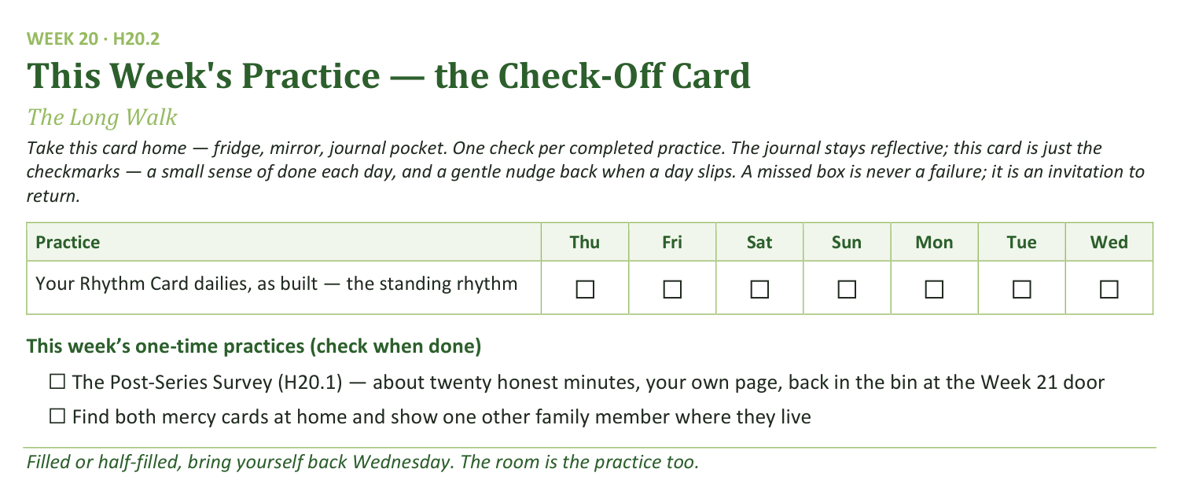
Your Take-Home Card — This Session’s Practice
Handed out now — fridge, mirror, journal pocket.
253
Notes:
S20 · 8:18–8:20 · LEAD: CONTENT PRESENTER CIRCLE
BEATS:
1. Check-off card H20.2: the Rhythm Card dailies, as built.
2. Two one-time boxes: the survey — twenty honest minutes, back in the Week 21 bin — and finding both mercy cards at home and showing one other family member where they live.
3. The cards gathering dust is the hope; everyone knowing the drawer is the point.

Slide 12
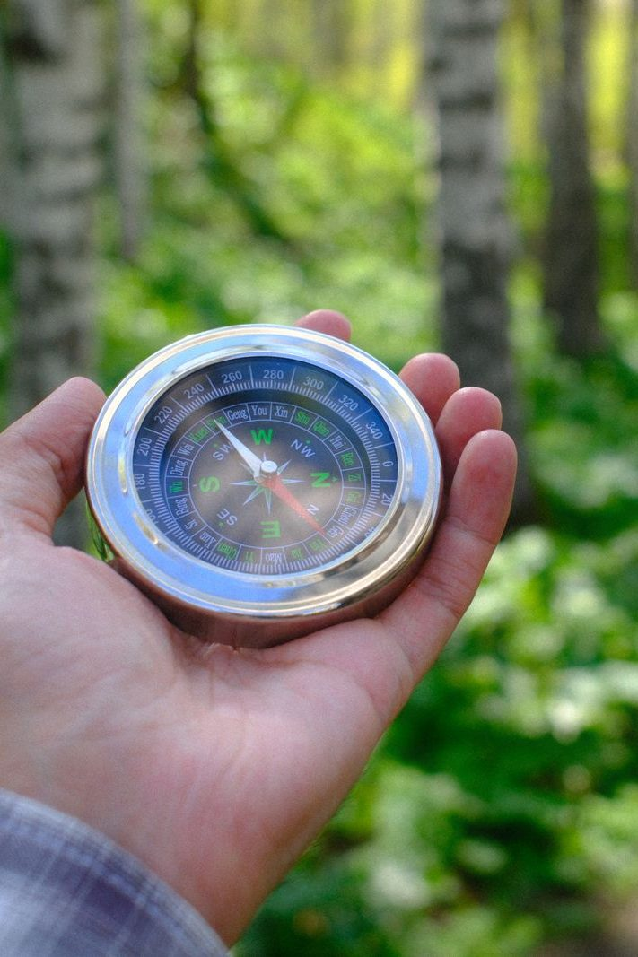
The Leader Feedback Round
• Two rounds, same as every session — the container holder first, then the content presenter: three things each
– “What I think went well tonight: ______”
– “What I’d do differently next time: ______”
– “If I were to teach tonight’s process to someone, I would tell them: ______”
• Then the room — the same two questions about tonight
• The leaders receive without defending — “thank you” is the whole response
254
Notes:
S20 · 8:24–8:28 · LEAD: BOTH LEADERS CIRCLE
BEATS:
1. Frame it: all year the journal has ended with 'if you were to teach this, what would you tell them?' — today the seniors stopped answering on paper and taught. They go first, together.
2. The seniors assess their own rep honestly, including anything that wobbled; then the room, two or three voices; received undefended — 'thank you' is the whole response.
3. Close the round with one specific witnessed sentence about what the room received because its own seniors carried the teaching.
CUES: If a freeze happened and the catch stepped in, honor it here in one sentence — the recovery was the leadership — never manage it away.

Slide 13
Closing the Container + Aaronic Blessing
• We close the way we opened — the container, six steps:
1 Stand again — same circle, same posture as the open
2 One-word landing — compare it to your opening word
3 The one thing you are taking from tonight
4 The one practice — committed aloud, or modified to one you will actually keep
5 Blessings — specific, witnessed, short
6 Closing prayer — and the Aaronic blessing, spoken over each other, face to face
THE AARONIC BLESSING — NUMBERS 6:24–26
“The Lord bless you and keep you;
the Lord make his face to shine upon you, and be gracious to you;
the Lord lift up his countenance upon you, and give you peace.”
255
Notes:
S20 · 8:28–8:30 · LEAD: CONTAINER HOLDER CIRCLE
BEATS:
1. Practice, two small pieces: the survey home and back; both mercy cards found at home and shown to one family member.
2. One-sentence summary: the dark stretch is not a verdict; the ache is the evidence He has not gone; the door is not locked and the light is on. This room now knows that — rooms that do are where people come home.
3. Name the two nights ahead: Week 21 sends the families — bring everyone; Week 22 commissions these Companions.
4. Standard closing protocol, then the Aaronic blessing, hands up. Go gently.

